Slide 1
NAME-VANSH AGARWAL
CLASS- XI-PCM
SESSION-2020-21
TOPIC-FAMOUS PLACE IN ARUNACHAL PRADESH

Slide 2
INTRODUCTION
There are times you are left to wonder if nature has been more kind to some parts of the earth. The world has many places that offer you great experiences, breathtaking moments and amazing views. Some tourist spots have beautiful mountains and stunning valleys; some are deserts but still have a great deal to offer. Each is beautiful in its own way and every place is unique for what it has to offer. While nature plays its game at its will on various locations, mankind had been playing its own game. Very few places have the best of everything and Arunachal Pradesh is one such place. The state is rich with picturesque beauty that offers relaxation and rejuvenation. The place offers you peace and action. Places of worship or wildlife sanctuaries, you name it; the state has it. Here are the top 9 places to visit in Arunachal Pradesh which you cannot afford to miss.

Slide 3
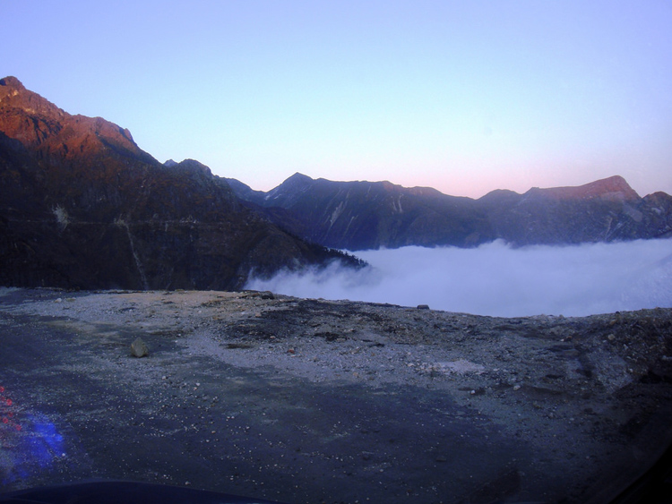
1. Tawang
With Tibet to its north, Bhutan to its southwest and Sela range of West Kameng to its east, Tawang captivates you with its scenic beauty. It is located 10000 feet above Mean Sea Level. Tawang has beautiful lakes around it and you will love the view offered by the place. The 400-year-old Tawang monastery is not only one among the oldest but it is named one among the largest Indian monasteries.
Places of Interest
Sela Pass
Tawang Monastery
Taktsang Gompa
Gorichen Peak
Shonga-tser Lake
Nuranang Waterfalls
Pankang Teng Tso Lake
Bumla Pass
Bap Teng Kang Waterfalls
Jaswant Garh

Slide 4
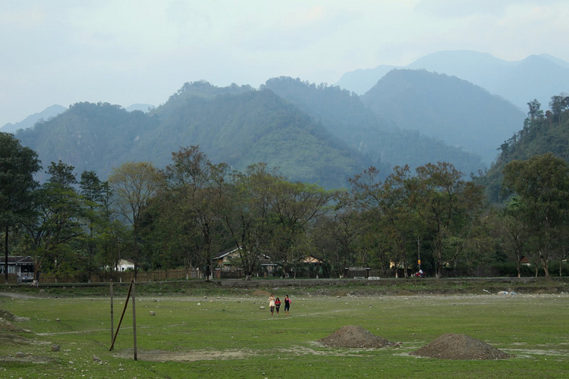
2. Roing
Roing is one of the most important tourist attractions in Arunachal Pradesh. It is located in Lower Dibang Valley. The picturesque beauty of the place attracts tourists from all parts of the world. Nature lovers, archeologists and adventure seekers will find the place engaging, educative and interesting. The place has many lakes and waterfalls and here you will find yourself at peace. A perfect place if you want to be in solitude.
Places of Interest
Mayudia
Mehao Lake
Mehao Wildlife Sanctuary
Bhismaknagar Fort
Hunli
Nijomagha

Slide 5
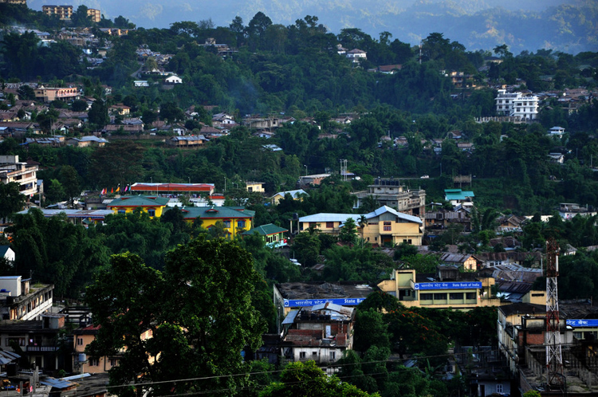
3.Itanagar
Your tour is incompleted wiithout visiting Itapur in Anurachal Pradesh, Ganga Lake, Polo Park and a lot more. Itanagar Wildlife Sanctuary is a sprawling sanctuary that houses various species including langur, antelopes, Himalayan black bear, porcupinesThe gallery in State Museum has great collections that speak of the rich heritage of the tribes in the state. Ganga Lake offers scenic views with the green forests and orchids. Polo Park is a botanical garden and it soothes your mind.
Places of Interest
Ganga Lake
Ita Fort
Itanagar Wildlife Sanctuary
Namdapha National Park
Polo Park
Jawaharlal Nehru State Museum
Gompa
Craft Centre And Emporium
Rapa
Indira Gandhi Park

Slide 6
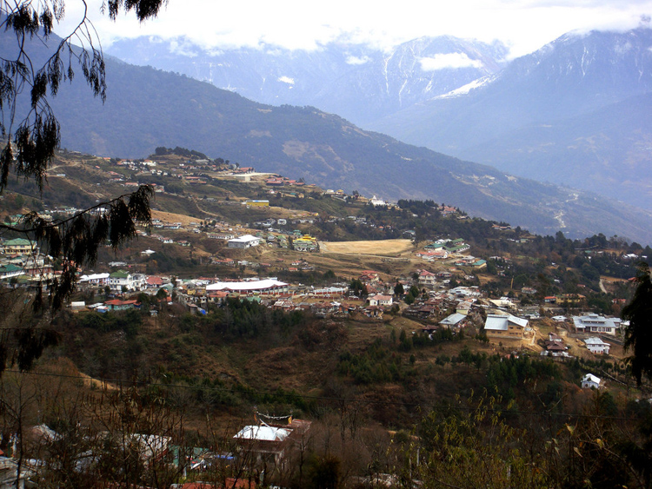
4. Bomdila
Bomdila is a perfect place if you are aiming to have a stunning view of snow clad Himalayan mountain ranges. It is situated 8000 feet above the sea level. The cool climate is enjoyable and so are the apple orchards and the beautiful surroundings. You could find a centre for crafts where local crafts are on display and a shopping centre.
Places of Interest
Sessa Orchid Sanctuary
Eaglenest Wildlife Sanctuary
Dirang Valley
Bomdila Monastery
Apple Orchards
Bomdila View Point
R.R. Hill
Craft Centre And Ethnographic Museum
How to Reach
Air
The nearest airport is Tezpur Airport, about 3 h 55 min (145.2 km) away and is connected to Kolkata and Guwahati. Hire a prepaid taxi from the airport or Tezpur to reach Bomdila.
Rail
The nearest Railway Station is Tezpur Railway Station (TZTB) which is connected to the majority of cities in India. There isn’t any rail connectivity within Arunachal Pradesh itself and visitors will need to take a cab from here to Bomdila.
Road
Bomdila has good road connectivity from all cities in Assam. Visitors can reach here through state run buses or take a cab from Assam. NH13 is the national highway connecting this cit

Slide 7
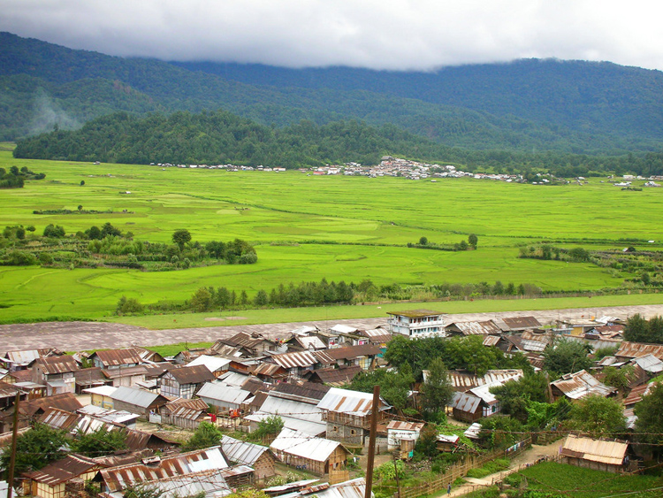
5.Ziro
Ziro is famously known as Apatani Plateau. Declared as a World Heritage Site, Ziro offers some of the best attractions in Arunachal Pradesh. While you are here, ensure that you visit Talley Valley, fish farm and Wild Life Sanctuary. Pine Bamboo groves found here look enchanting.
Places of Interest
Talley Valley Wildlife Sanctuary
Meghna Cave Temple
Kile Pakho
Midey
Ziro Puto
Dolo Mando
Hapoli
Dilopolyang Maniipolyang
Pine Grove
Tarin Fish Farm
Bamboo Grove
Tipi Orchid Research Centre
How to Reach
Air
The nearest airport is Tezpur Airport, about 7 h 5 min (271.2 km) away and is connected to Kolkata and Guwahati. Hire a prepaid taxi from the airport or Tezpur to reach Ziro.
Rail
The nearest Railway Station is Tezpur Railway Station which is connected to the majority of cities in India. There isn’t any rail connectivity within Arunachal Pradesh itself and visitors will need to take a cab from Tezpur railway station (TZTB) to Ziro.
Road
The best route to travel would be by road. State run buses to Ziro run mainly from Itanagar and sometimes from Assam. Cabs are also a good option and can be taken from Assam or Arunachal Pradesh.

Slide 8
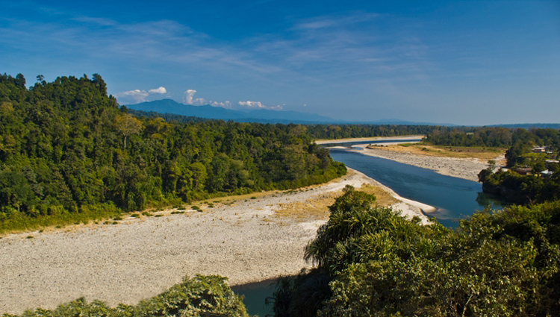
6.Bhalukpong
Looking around the beauty of Arunachal Pradesh and lost in its tranquility, if you seek a change, this is where you need to be. Bhalukpong keeps your body and mind engaged. The options are many if you seek adventure. You could go hiking, trekking and river rafting. The hills that surround Bhalukpong offer you great opportunity to go trekking. Once you are here, do visit The Kaziranga National Park and Pakhui Wildlife Sanctuary.
How to Reach
Air
The nearest airport is Tezpur Airport, about 1 h 2 min (48.6 km) away and is connected to Kolkata and Guwahati. Hire a prepaid taxi from the airport or Tezpur to reach Bhalukpong.
Rail
The nearest Railway Station is Tezpur Railway Station which is connected to the majority of cities in India. There isn’t any rail connectivity within Arunachal Pradesh itself and visitors will need to take a cab from here to Bhalukpong.
Road
State buses to Bhalukpong run primarily from Tezpur (48.6 km), Guwahati (241.3 km) and other parts of Arunachal Pradesh. Cabs can also be availed from any part of north east to Bhalukpong. Places of Interest:
Pakhui Wildlife Sanctuary
Kaziranga National Park
Bhalukpong Fort
Tipi
Bomdil

Slide 9
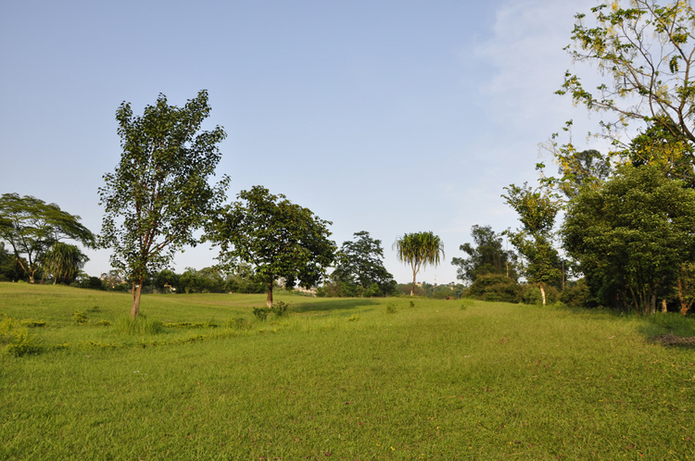
7.Pasighat
Named the gateway to Arunachal Pradesh, this is the oldest town of the state. It is located on the banks of Siang River and it is 155 meters above the sea level. The place is blessed with the kindness of nature and you will find mind-blowing views. The majestic river Brahmaputra flows to this place from Tibet. Pangin and Daying Ering Wildlife Sanctuary are two top attractions here.
How to Reach
Air
The nearest airport is Dibrugarh Airport, about 4 hr 22 min (164.4 km) away and is connected to Kolkata, Delhi and Guwahati. Hire a prepaid taxi from the airport or Dibrugarh to Pasighat.
Rail
The nearest railway station is Dibrugarh railway station (DBRG) which is connected to the majority of cities in India. There isn’t any rail connectivity within Arunachal Pradesh itself and visitors will need to take a cab from Dibrugarh railway station (DBRG) to Pasighat.
Road
State buses run regularly to Pasighat from all cities of Assam and Arunachal Pradesh. The best option would be to take a cab from Dibrugarh (154.6 kms) about 4 hours away to Pasighat.

Slide 10
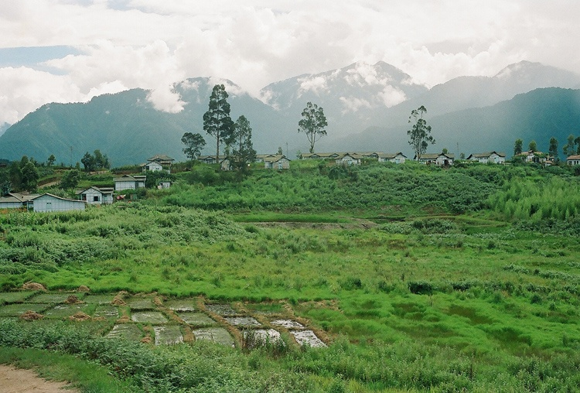
8.Anini
Anini is one of the most enticing places in Arunachal Pradesh. Although the history of the place is a bit clouded, it is said to have housed the Idu Mishimi who migrated from Tibet around the 1st millennium BC. The Town is located atop a Plateau between two tributaries of the mighty Brahmaputra river. Due to its high elevation above sea level, the town enjoys a pleasant climate throughout the year and is a great place to visit with several natural and man made tourist attractions making Anini a perfect location for mental relaxation.
How to Reach
Air
Roing, about 5 hours away is the nearest town with better connectivity. Therefore, reach Roing first from the nearest airport in Dibrugarh Airport about 145.6 km (3 h 49 min) away. Take a cab from Roing to Anini.
Rail
The nearest railway Station is Dibrugarh Town Railway Station (DBY), about 151 km (4 hr) away from Roing and is connected to the majority of cities in north east. There isn’t any rail connectivity within Anini and visitors will need to take a cab from Roing.
Road
Tinsukia, near Dibrugarh in Assam is the nearest town having bus connectivity from all cities in north east. Visitors need to travel to Tinsukia first and take a bus from here to Roing, about 160 kms (4-5 hours) away and then take a cab from Roing to reach Anini.

Slide 11
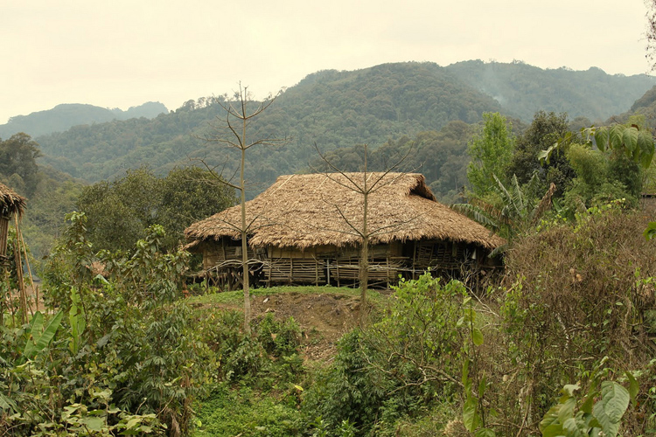
9.Along
Along is a place to be if you come along to Arunachal Pradesh. It is situated near Assam’s border. The valley is picturesque surrounded by mountains with rivers flowing through them. The place has various attractions. Kane Wildlife Sanctuary, which is situated here, houses wild species such as elephants and deer. The Hanging Bridge on River Siang is made of cane and bamboo. You could go river rafting and trekking if you are keen to have some activity to challenge your physical ability.How to Reach
Air
The nearest airport with the best connectivity is Dibrugarh Airport, about 6 hr (259.6 km) away and is connected to Kolkata, Delhi and Guwahati. Hire a prepaid taxi from the airport or Dibrugarh to Along.
Rail
The nearest railway station with the best connectivity is Dibrugarh railway station (DBRG), about 6 hours away which is connected to the majority of cities in India. Silapathar (SPTR), about 3 hours away is the nearest railway station but has limited connectivity outside north eastern states.
Road
State buses run regularly to Along from all cities of Assam and Arunachal Pradesh. The best option would be to take a cab from Dibrugarh (154.6 kms) about 6 hours away to Along

Slide 12
Thankyou

